Slide 1
RULE OF EXERCISE
STEP 1: Execute in paper first to find the output
STEP 2: Write code test and compare result with STEP 1

Slide 2
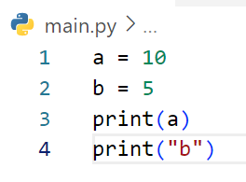
Define the output of code below
10
b

Slide 3
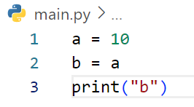
Define the output of code below
b

Slide 4
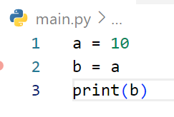
Define the output of code below
a

Slide 5
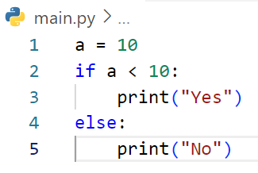
Define the output of code below
No

Slide 6
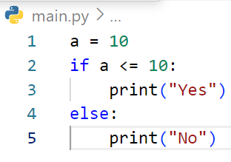
Define the output of code below
Yes

Slide 7
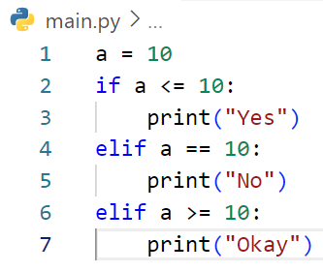
Define the output of code below
Yes

Slide 8
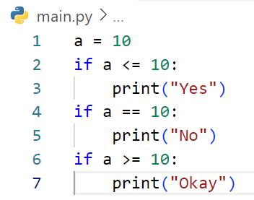
Define the output of code below
Yes
No
Okay

Slide 9
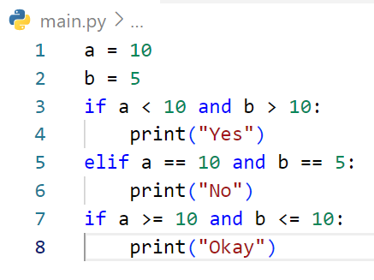
Define the output of code below

Slide 10
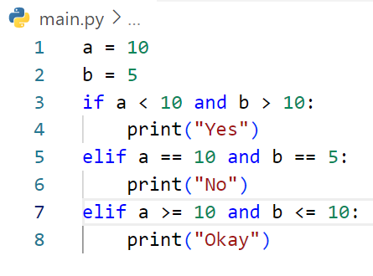
Define the output of code below

Slide 11
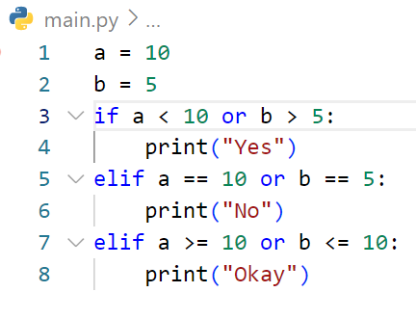
Define the output of code below

Slide 12
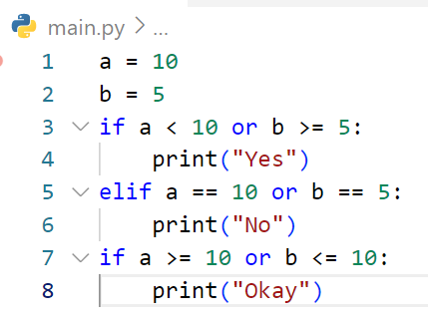
Define the output of code below

Slide 13
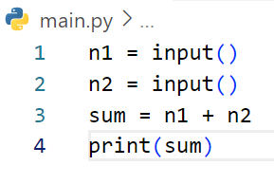
Define the output of code below
# If user enter first : 3 and second 5

Slide 14
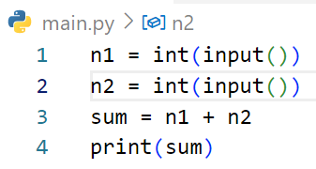
Define the output of code below
# If user enter first : 3 and second 5

Slide 15
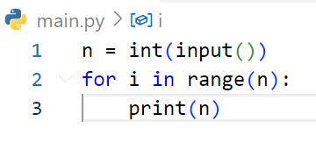
Define the output of code below
# If user enter : 3

Slide 16
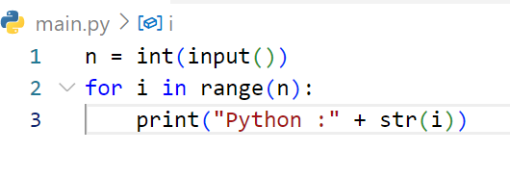
Define the output of code below
# If user enter : 3

Slide 17
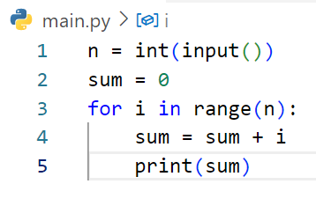
Define the output of code below
# If user enter : 3

Slide 18
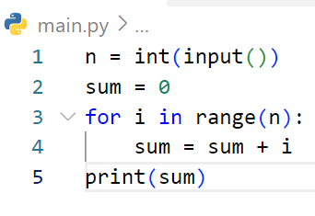
Define the output of code below
# If user enter : 2

Slide 19
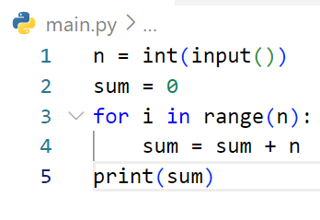
Define the output of code below
# If user enter : 4

Slide 20
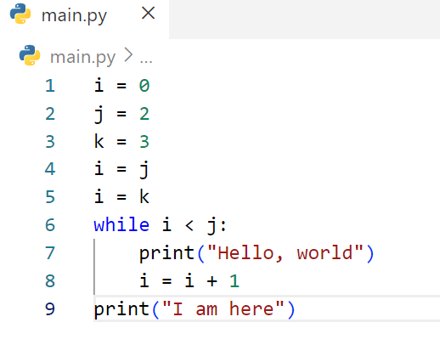
Define the output of code below

Slide 21
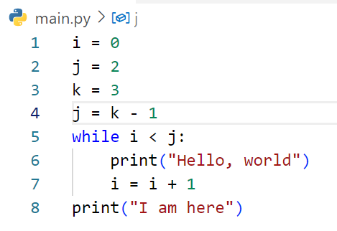
Define the output of code below

Slide 22
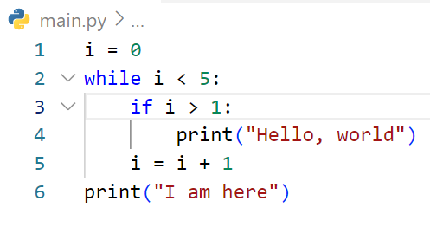
Define the output of code below

Slide 23
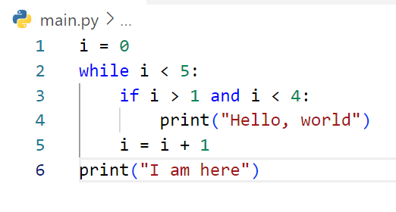
Define the output of code below

Slide 24
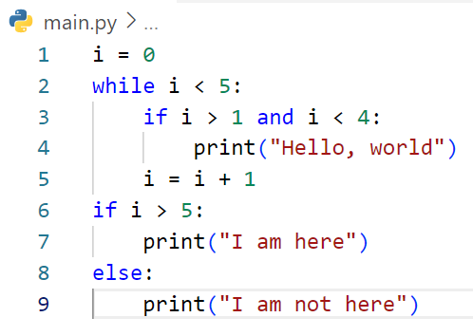
Define the output of code below

Slide 25
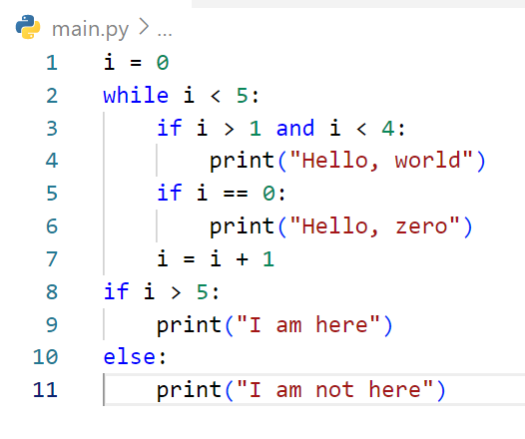
Define the output of code below

Slide 26
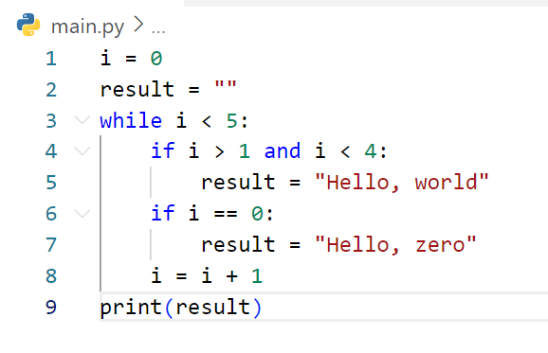
Define the output of code below

Slide 27
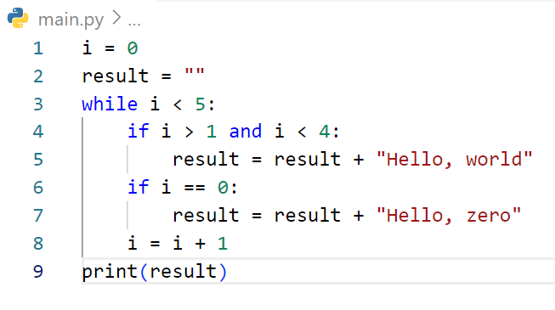
Define the output of code below

Slide 28
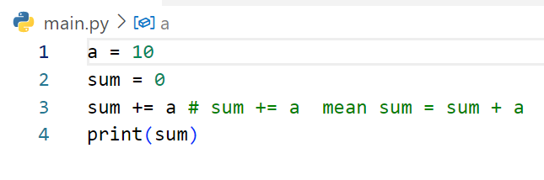
Define the output of code below

Slide 29
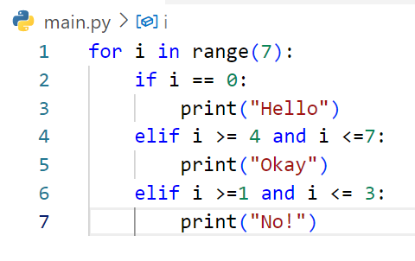
Define the output of code below

Slide 30
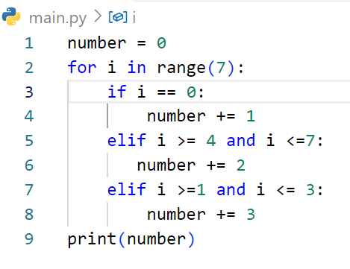
Define the output of code below

Slide 31
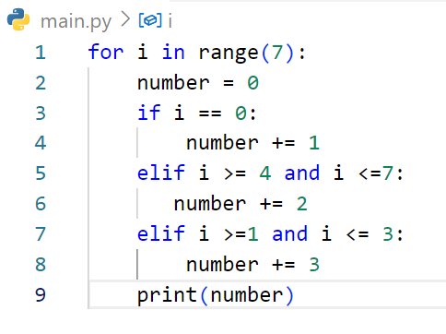
Define the output of code below

Slide 32
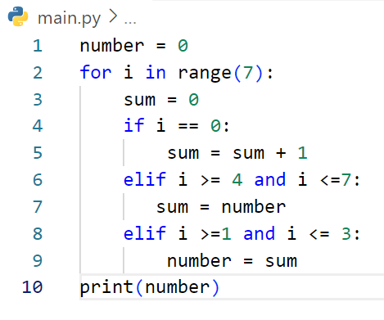
Define the output of code below

Slide 33
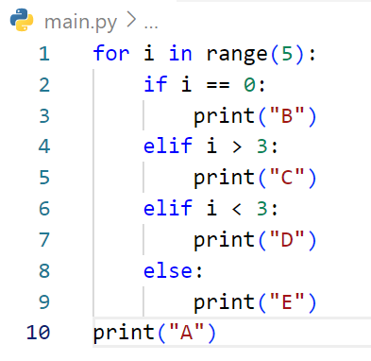
Define the output of code below

Slide 34
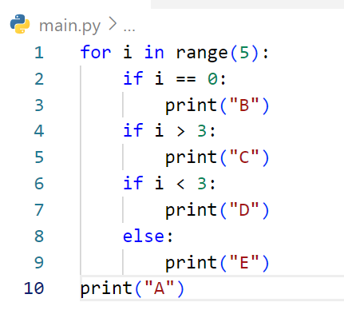
Define the output of code below

Slide 35
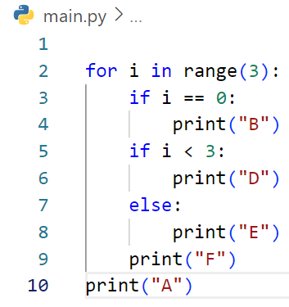
Define the output of code below

Slide 36
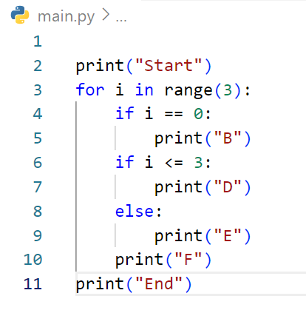
Define the output of code below

Slide 37
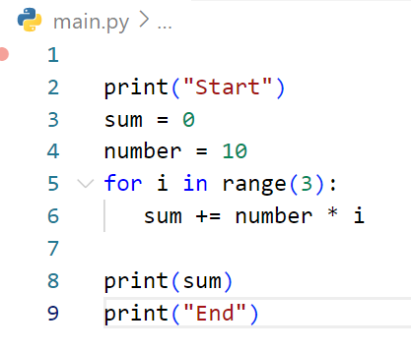
Define the output of code below

Slide 38
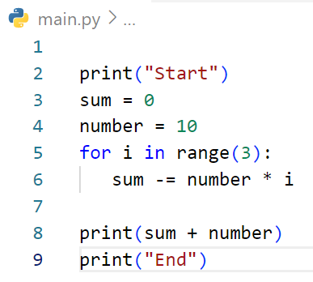
Define the output of code below

Slide 39
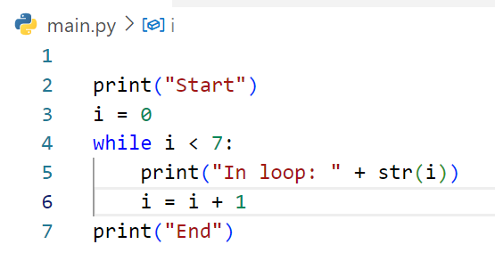
Define the output of code below

Slide 40
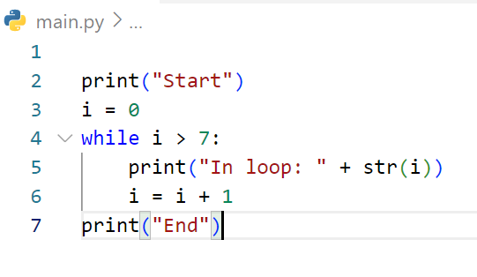
Define the output of code below

Slide 41
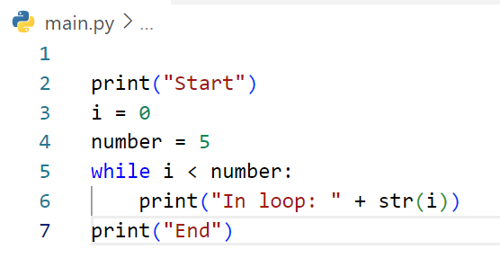
Define the output of code below

Slide 42
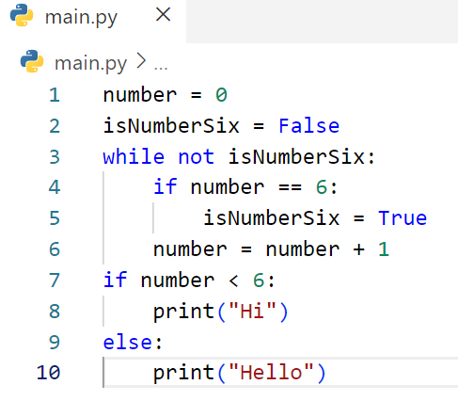
Define the output of code below

